Slide 1

HACKATHON’20 WEB PORTAL TN COVID SURVEILLANCE
VELTECH RANGARAJAN DR. SAGUNTHALA R&D INSTITUE OF SCIENCE AND TECHNOLOGY
PRESENTING:
BALAJI. C (VTU 11349)
NITISH KRISHNA .B (VTU 11360)
JAWAHAR .V (VTU 11361)
JURY MEMBER:
MR.MOHAMMED IQBAL M.TECH.,

Slide 2
1.ABSTRACT
Human history is observing a very strange time fighting an invisible enemy, the novel COVID-19. ‘Corona virus’. Initially observed in the Wuhan province of China, now fastly spreading around the world. Corona viruses are a large family of viruses which may cause illness in animals or humans. In humans, several corona viruses are known to cause respiratory infections ranging from the common cold to more severe diseases such as Middle East Respiratory Syndrome (MERS) and Severe Acute Respiratory Syndrome (SARS). The most recently discovered corona virus causes corona virus disease COVID-19.

Slide 3
2.INTRODUCTION
COVID-19 is the infectious disease caused by the most recently discovered coronavirus. This new virus and disease were unknown before the outbreak began in Wuhan, China, in December 2019. COVID-19 is now a pandemic affecting .The most common symptoms of COVID-19 are fever, dry cough, and tiredness. Other symptoms that include aches and pains, nasal congestion, headache, conjunctivitis, sore throat, diarrhea, loss of taste or smell or a rash on skin or discoloration of fingers or toes. These symptoms are usually mild and begin gradually. Some people become infected but only have very mild symptoms.
Most people (about 80%) recover from the disease without needing hospital treatment. Around 1 out of every 5 people who gets COVID-19 becomes seriously ill and develops difficulty breathing. Older people, and those with underlying medical problems like high blood pressure, heart and lung problems, diabetes, or cancer, are at higher risk of developing serious illness. However, anyone can catch COVID-19 and become seriously ill. People of all ages who experience fever and/or cough associated withdifficulty breathing/shortness of breath, chest pain/pressure, or loss of speech or movement should seek medical attention immediately.

Slide 4
3.SCOPE
Our major aim is to provide the detailed report and analysis of Covid-19 in Tamil Nadu. Here, we made a simple front end web portal page. That contains, the survey, in which the user can enroll his own personal information, and it contains statistical reports of covid-19 in TN. The statistical reports are plotted in bar graph for easy understanding. Number of active cases till today are plotted in graph. Next, covid-19 analysis tab, which includes covid-19 symptoms and prevention tips and techniques are mentioned. Next, district wise helpline numbers are pinned in the helpline tab. And, we have also included a sample health test case for the users. The users can answer every question asked in order to know whether they are affected or not. This is our scope study of TN Covid-19 Surveillance web portal page.

Slide 5
4.METHODOLOGY
Here, we made a simple front end web portal page of Covid-19 in the Tamil Nadu state. In which the web portal page contains the following as,
4.1 Home Page
In home page the user can enroll their own personal information to verify. The user should enter their name, their gender, their age, In which zone they are located to, and their district, state, address of identification, and their health issues if any.

Slide 6
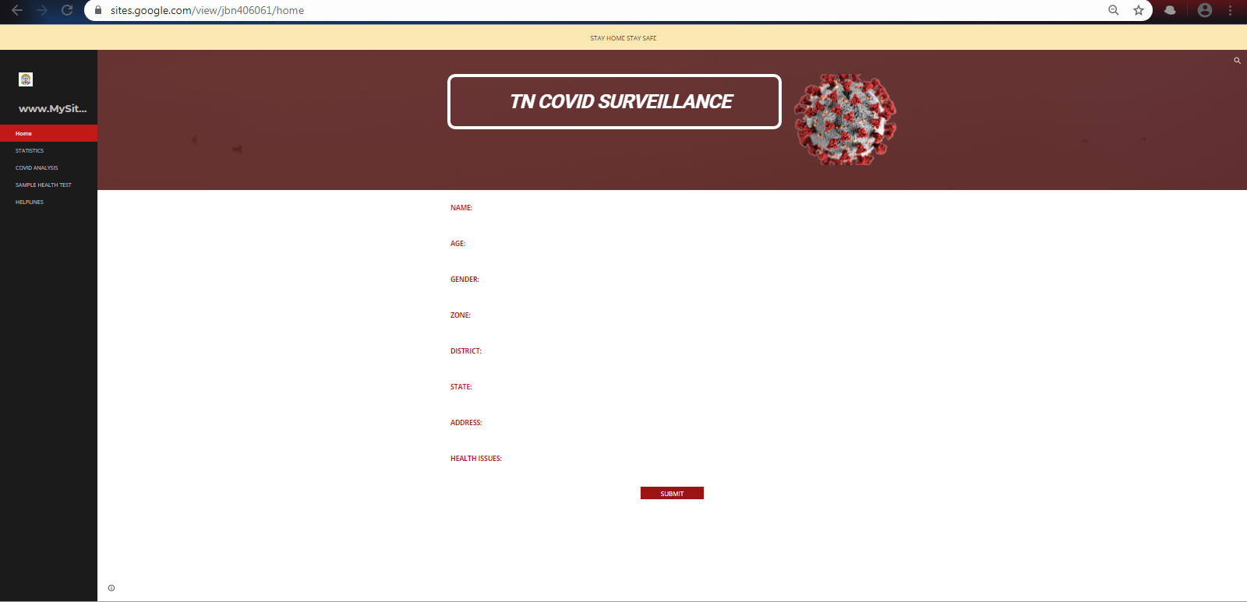
4.2 STATISTICS
The statistical reports are plotted in bar graph for easy understanding. Number of active cases till today are plotted in graph. The date wise active cases in India as well as in Tamil Nadu are plotted there. And spread rate is also calculated.

Slide 7
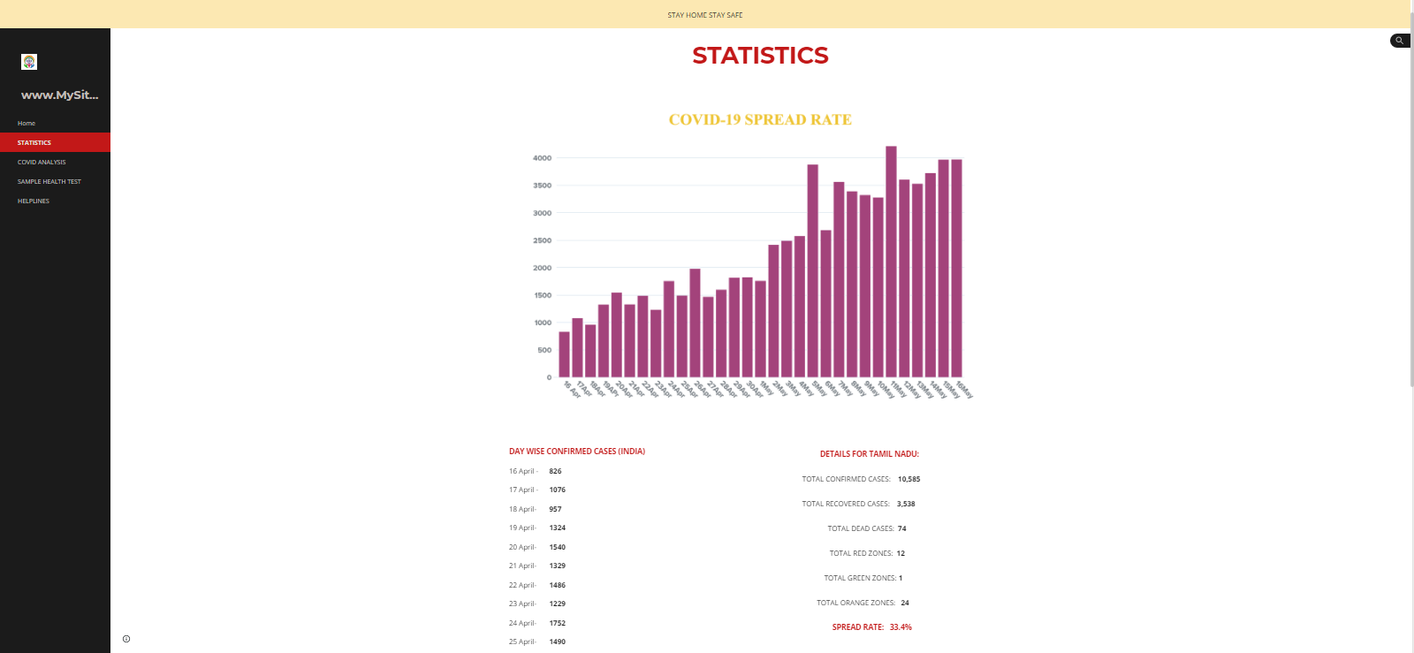
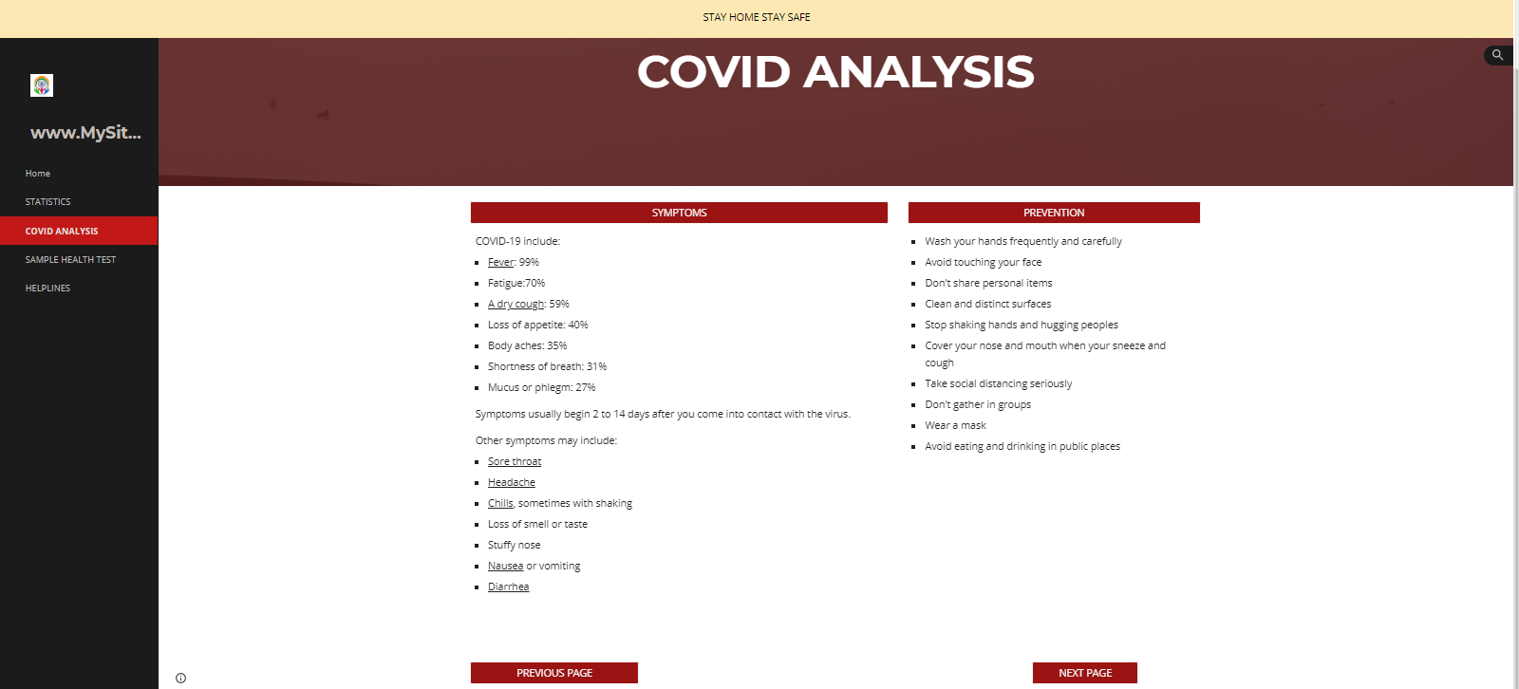
4.3 COVID ANALYSIS

Slide 8
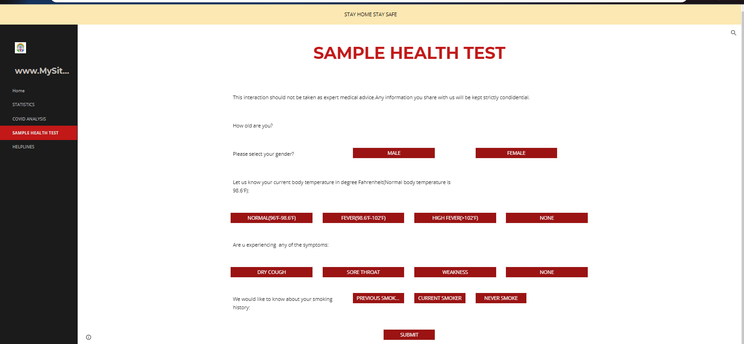
Covid-19 analysis tab, which includes Covid-19 various symptoms of covid-19 and prevention tips and techniques to prevent from corona are mentioned in this Covid analysis tab.
4.4 SAMPLE HEALTH TEST

Slide 9
This is a sample health test case for the users. The users should answer mentioned questions asked in order to know whether they are affected or not. And to find the probability of being affected by Covid-19.
4.5 HELPLINE NUMBERS
District wise helpline numbers are pinned in the helpline tab. The users can contact helpline centre (district wise) when they are need of an emergency.

Slide 10
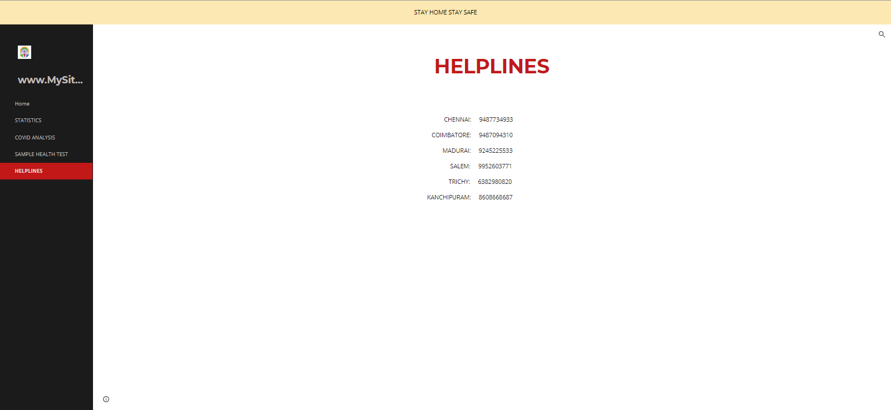

Slide 11
5.RESULT AND DISCUSSIONS
Here, we conclude that, the user can get the detailed report and analysis of Covid-19 in Tamil Nadu. In our simple front end web portal page done in google site. The user can enroll their personal information to verify. The user should mention their name, age, gender, address, and their health issues if any. He can also get the district wise helpline numbers to contact the helpline center in neeed of an emergency. He can view and check the number of affected cases till now which is plotted in the bar graph. Here we mentioned some prevention tips and techniques which the user can refer. And we also pinned some of the symptoms of being affected by Covid-19. And finally we have prepared a sample health test questions. Here the user should answer all the questions asked to know whether he is affected or not. It gives an idea for the user whether he should approach the medical centre or not. Here, we are pinning our link of our front end web portal page about Covid-19 in Tamil Nadu for your kind perusal.
The link: https://sites.google.com/view/jbn406061/home

Slide 12
REFERENCES
[1]. https://www.who.int/emergencies/diseases/novel-coronavirus-2019/question-and-answers-hub/q-a-detail/q-a-coronaviruses
[2]. https://www.mygov.in/covid-19
[3]. https://covid.apollo247.com/
[4]. https://www.mohfw.gov.in/pdf/FAQ.pdf
[5]. https://www.unicef.org/coronavirus/covid-19

Slide 13
THANK YOU

